Slide 1
Workshop
State of Washington
Mar 15, 2022

Slide 2
3 session agenda
Session #1 - learning session
↪ Overview, methods, and goals
Session #2 - small group work session
↪ Product vision, roadmap review, and decision points
Sessions #3 - small group work session
↪ QASP review + agile contract format

Slide 3
Session #3 agenda
QASPs
Agile contract format
Product team roles
Modular contracting
Reflection + next steps

Slide 4
Quality Assurance Surveillance Plans (QASPs)

Slide 5
Who’s excited to talk about QASPs?

Slide 6
Not me, actually.

Slide 7
Uh…

Slide 8
1/ What’s the goal?

Slide 9
What’s the goal?
Quality - How good is the thing?
Assurance - How confident are we? What are the risks?
Surveillance - How are we watching?
Plan - How will we do it?
Notes:
This is what QASP stands for. Quality assurance surveillance plan. You already know that. You saw the title slide.

Slide 10
The ultimate goal is not documentation. It’s not tested code, multiple deployment environments, or any kind of automation. It’s none of the stuff in the QASP.
What’s the goal?

Slide 11
The goal is a product that serves users’ needs.
What’s the goal?

Slide 12
So what’s this part of the workshop about, exactly?

Slide 13
2/ Getting what you need

Slide 14
Getting what you need
A product that serves users’ needs…

Slide 15
Getting what you need
A product that serves users’ needs…
…requires conducting research with users to understand their needs…

Slide 16
Getting what you need
A product that serves users’ needs…
…requires conducting research with users to understand their needs…
…requires rapid feedback on ideas to see how the product is meeting or missing their needs…

Slide 17
Getting what you need
A product that serves users’ needs…
…requires conducting research with users to understand their needs…
…requires rapid feedback on ideas to see how the product is meeting or missing their needs…
…requires rapid iteration on the product design and implementation

Slide 18
You need a skilled, empowered team that directly demonstrates its progress; and observable metrics that reflect health and sustainability.
Notes:
In order to be confident you’re moving towards what you need, you have to have a relatively small team that’s empowered to move and make decisions. That team will demonstrate its progress, not just talk about it. “Demos, not memos” is something you may have heard before. And that team needs observable metrics that provide an indirect insight into the health of the team, the processes, and the product itself.

Slide 19
You need a skilled, empowered team that directly demonstrates its progress; and observable metrics that reflect health and sustainability.
Notes:
Well you already have the team, so that part’s taken care of. What about those observable metrics?

Slide 20
3/ The traditional way

Slide 21
Paper deliverables
Governance quality management plan
Integration/architecture plan
Communication management plan
Risk/issues management plan
Testing plan
Change and configuration management plan
Post-implementation review plan
Performance reporting summary
Training plan
Notes:
I don’t know about Washington’s traditional approaches, but this is what we’ve seen elsewhere. Paper deliverables. Reports. Usually at some regular, infrequent interval. Maybe every quarter, or 6 months. Hundreds of pages of stuff. But all of these are just attestations. They’re not demonstrations of anything. And they certainly aren’t a working product.

Slide 22
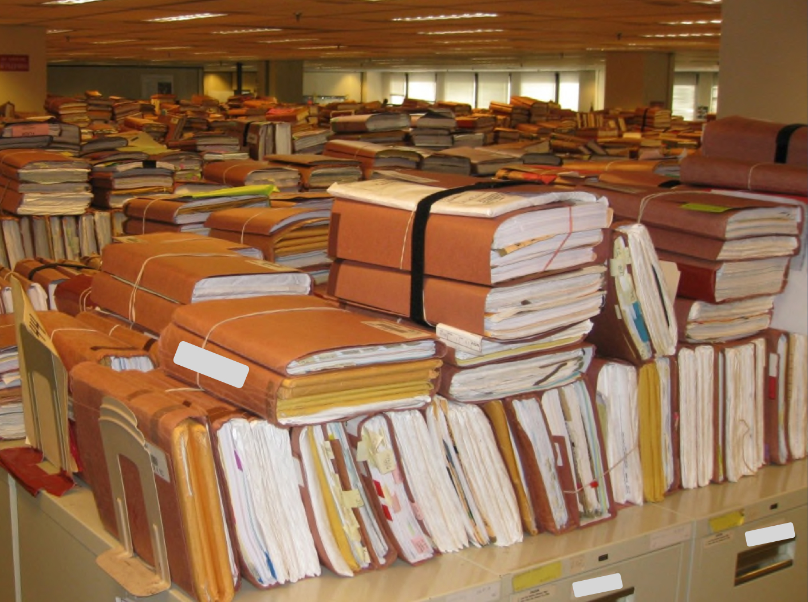
Paper deliverables
Notes:
They’re just warehouses full of paper. Randy can talk about this. He had a whole filing cabinet of paper deliverables for a single contract one time. Randy, how did that work out for you?

Slide 23
Historically, all our contracts paid for paper, which I never understood. [...] When we talked to other states, they had rooms of binders worth millions of dollars. Those binders never pay claims!
“
”
Notes:
When we were doing our Medicaid IT contracts termination research, this is what we heard from one of our interviewees. But you have to have some way to make sure you’re getting the things you need. So…

Slide 24
4/ The QASP

Slide 25

Notes:
We’re going to talk about the QASP now.

Slide 26
The QASP
A collection of “performance standards” that define metrics, minimum standards, and how they’ll be measured
These should be quantitative metrics that can effectively translate to a checklist
The QASP is only a tool for gauging product quality and adherence to team processes.
The performance standards are not a replacement for having conversations
Notes:
[ read the slide, and then… ]
Now we’re going to take a look at the kinds of performance standards that 18F has in its standard QASP. There aren’t a lot. It’s not supposed to be exhaustive, it’s just supposed to capture some key, qualitative metrics that reflect team and product health.

Slide 27
The QASP: 18F’s standard elements
Tested code
Properly-styled code
Accessible user interface
Deployed code
Documentation
Secure code
User research
Accepted features
Notes:
The 18F standard QASP template has these 8 elements in it. You don’t need to use them all, and you can add more if you need to. But the key is to focus on metrics of quality, not metrics of quantity. When you really focus in on indicators of quality, you’ll find that you don’t really need to include very many elements. Like I said, ours usually has 8 elements, and sometimes we add another one or two, depending on the project needs.

Slide 28
Reminder: Getting what you need
A product that serves users’ needs…
…requires conducting research with users to understand their needs…
…requires rapid feedback on ideas to see how the product is meeting or missing their needs…
…requires rapid iteration on the product design and implementation
Notes:
And quickly, a reminder what we’re trying to get to: a product that serves users’ needs.

Slide 29
The QASP doesn’t give you any of that.
Notes:
Having a QASP doesn’t magically give you a product that meets user needs.

Slide 30
The QASP doesn’t give you any of that. It’s a framework you can use to measure progress on those things.
Notes:
But it does give you a framework for measuring the quality of your progress. And as we’ll see, that’s all it is: measurements. If your vendor comes up short, how you respond is up to you. You can talk to the vendor about the shortcomings and how you’ll get everything up to the standards in the QASP. Or if that doesn’t work… well, then you can start looking at your other contractual remedies.

Slide 31
If you want good outcomes, it’s still your responsibility to make sure you’re getting them.
Notes:
But at the end of the day, it’s still up to you to get good outcomes. You can’t outsource your mission, and the delivery of services that meet Washingtonians’ needs is your mission. It’s not the vendor’s mission. No matter how mission-oriented the individual humans on the vendor team may be, the vendor’s - the company you’re paying’s - ultimate mission is to make money. So if you want good outcomes, you have to make them happen. And the QASP is a tool to help you know whether or not that’s happening.

Slide 32
The QASP: tested code
Standard: Code delivered under the order must have substantial automated test coverage.
Acceptable level: Minimum of 90% of code covered by automated tests. All areas of code are meaningfully tested.
Method of assessment: Combination of manual review and execution of the automated tests.
Notes:
Okay, so on these slides, there’s a lot of text. I’m not going to read it all and you don’t have to read it all, either. We send out our template QASP beforehand, and we’ll share these slides as well so you don’t need to memorize anything. There’s no quiz. But I want to go through these typical QASP performance standards to show how they link back to your needs.
The standard is the metric being observed. The acceptable level is the minimum that the government will accept. And the method of assessment describes how the government expects to do its assessments. This one can serve as a hint to your vendor team about how you expect them to work.
—
Automated tests are ones that are run… I mean, obviously, automatically. Basically it’s a computer program that runs your program and sends it inputs and checks the outputs. There are several different kinds of tests, and it’s reasonable to expect some of all of them because they serve different needs. Some of them test tiny pieces of internal functionality to make sure it works as expected - like if you’re doing any monetary calculations before you show it to a user, you might want really thorough tests for a bunch of weird edge cases to make sure it’s going to behave properly. Then there are tests that actually simulate a user by opening your product and clicking on buttons, typing text, and so on, and verifying that everything responds correctly. This standard is saying that the code your vendor delivers has to have those tests.
That 90% code covered comment means that when the tests run, at least 90% of the code is executed during the tests. That helps make sure everything is being tested, not just some parts. There’s one caveat I want to call out here, which is that it’s possible, and in fact super easy, to create tests that will always pass, no matter what, and that will cover 100% of the code. So ideally you’ll still have someone on the state side that can review the code itself to make sure the tests are actually meaningful.

Slide 33
The QASP: tested code
A product that serves users’ needs…
…requires conducting research with users to understand their needs…
…requires rapid feedback on ideas to see how the product is meeting or missing their needs…
…requires rapid iteration on the product design and implementation
Notes:
Tested code is important for ensuring that your product meets users’ needs and enabling rapid iteration on the implementation.
The purpose of tests is to memorialize code that is already working. That way, if it stops working, you’ll know it right away because the tests will suddenly fail. If you’re iterating rapidly, the tests can help you catch bugs before they ever leave the developer’s computer. When I’m writing code, there’s nothing quite so cool as having an old test catch a new bug for me. You can move quickly and with confidence because everything you’ve done before is being checked to make sure it still works.
The tests also directly help ensure you’re meeting users’ needs. Once a feature works and users are happy with it, your tests can help ensure you don’t accidentally make changes to that feature. Code can be pretty complex with weird interrelationships, and a code change in one place can have unexpected consequences elsewhere. Tests help protect you from that.

Slide 34
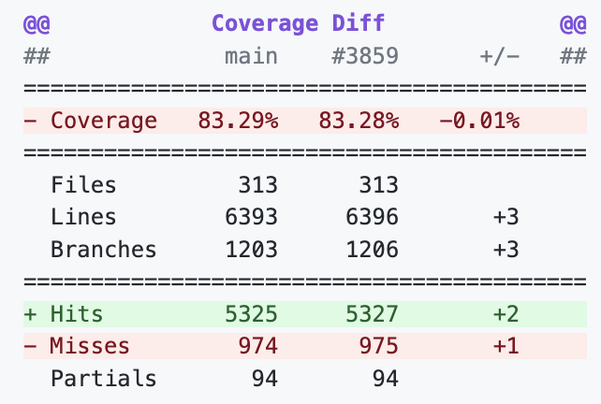
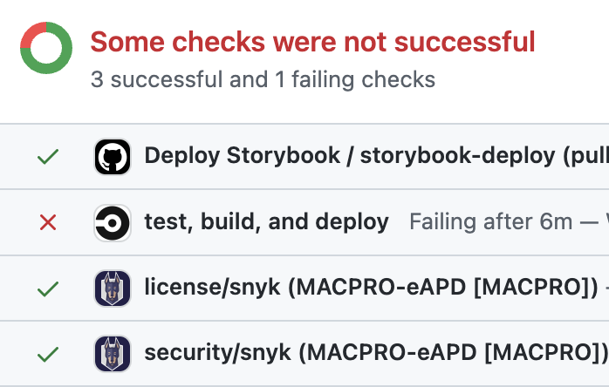
The QASP: tested code
How to assess it day-to-day
Automated test outputs will let you know if any tests are failing
Test outputs should also report on code coverage
Code reviews will verify that tests are meaningful
Notes:
How do you check it? Well, your vendor will write the tests and set up the automation, so all you should need to do is look at the checklist and make sure it’s green. If it’s not, you know that’s something to talk to your vendor about. The platform RFP includes a requirement to include the kinds of tools your product vendor will use to run these tests, and those tools will tell you whether tests pass or fail. The tools should also be able to tell you what percentage of the code is covered by tests.
There should be some amount of manual code review, as I mentioned a minute ago, to make sure your vendor isn’t trying to game the system with a bunch of high-coverage, low-value tests.

Slide 35
The QASP: tested code
DISCUSSION:
Who will do the assessment?
Notes:
I want to open the floor for discussion, but really quickly, I want to make an important point: product owners are responsible for quality delivery. That said, there’s a difference between being responsible for a thing getting done, and being responsible for doing the thing. So we wouldn’t generally expect the product owners to assess the performance under the QASP themselves. We’d expect other members of the product team to do that and serve as advisors to the product owners. With that in mind, who do y’all think would be responsible for assessing the tested code element of the QASP?

Slide 36
The QASP: properly-styled code
Standard: Code conforms to [link to a code style guide, such as the 18F engineering style guide].
Acceptable level: Zero linting errors and zero valid warnings.
Method of assessment: Combination of manual review and execution of the automated tests.
Notes:
Properly-styled code refers to how the code itself is written. Code is just text, but over time we’ve built up a lot of standards and best-practices for how it’s formatted. Think of it like grammar: where does your punctuation go? What letters get capitalized? Actually, those are literally things that would be covered in a code style guide. Most people will probably never see the code, but conforming to a style is pretty valuable.

Slide 37
The QASP: properly-styled code
A product that serves users’ needs…
…requires conducting research with users to understand their needs…
…requires rapid feedback on ideas to see how the product is meeting or missing their needs…
…requires rapid iteration on the product design and implementation
Notes:
It helps to enable rapid implementation iterations. When all of the code adheres to a common style guide, it makes it easier for new developers to join the project so the product team is more resilient to change. If your vendor team needs to swap out one developer for another, that’s okay – your properly-styled code is easier for them to pick up. It also makes it easier to switch vendors altogether if necessary.
As an added bonus, most style guides also address best practices around secure and performant security practices, so it makes you a little less susceptible to major security bugs and sluggish performance.

Slide 38
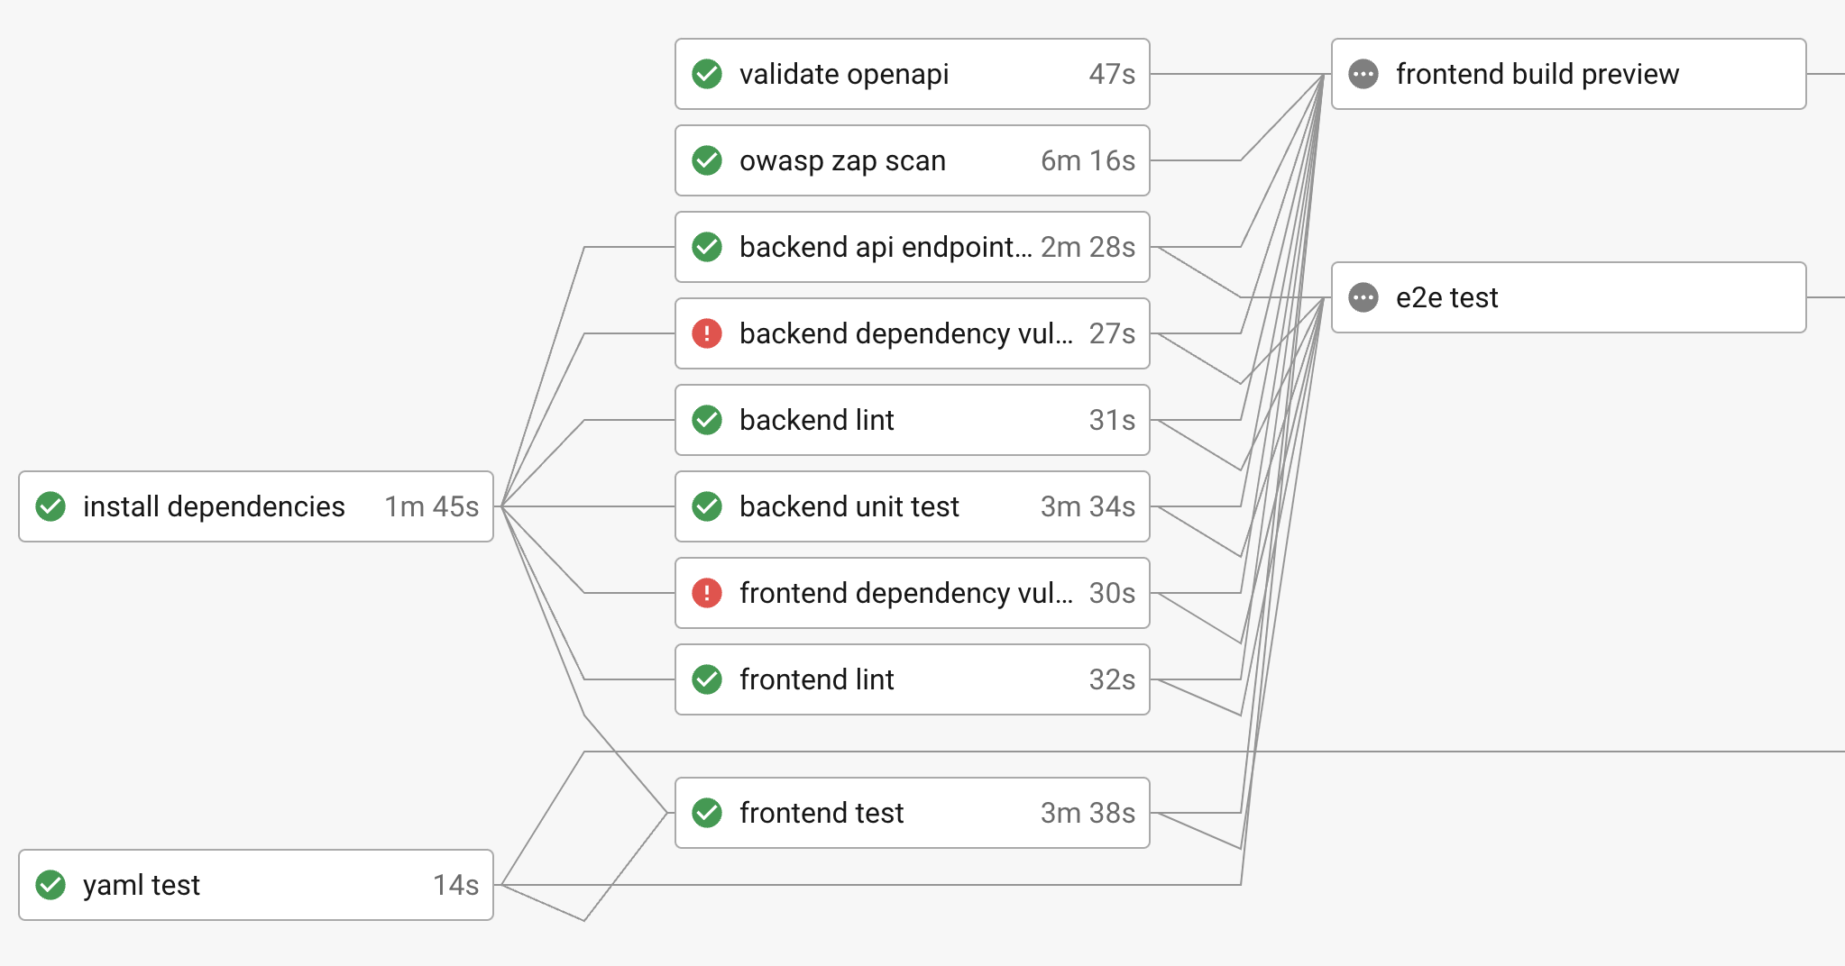
The QASP: properly-styled code
How to assess it day-to-day
Automated code scans will show most deviations from your approved code style
Code reviews will provide visibility into the kinds of things automated tools can’t catch
Notes:
Assessing properly-styled code is a lot like assessing tests: automated tools will tell you about most deviations, and code reviews can catch things the tools don’t. With most automated tools, it’s also possible to disable them from within the code, so a code review is useful to make sure that’s not happening unreasonably. Sometimes it’s the right thing to do, but you want to make sure it’s documented why it was turned off in a particular place.

Slide 39
The QASP: properly-styled code
DISCUSSION:
Who will do the assessment?

Slide 40
The QASP: accessible user interface
Standard: Web Content Accessibility Guidelines (WCAG) 2.1 AA.
Acceptable level: Zero errors reported by automated scanners and zero errors reported in manual testing. Agency-required documentation of accessibility status is completed.
Method of assessment: Combination of automated and manual testing with tools equivalent to [insert example tools acceptable to the agency, such as Accessibility Insights or the DHS Trusted Tester program].
Notes:
Accessibility refers to making sure everyone can use your product, regardless of ability or disability. You may sometimes hear this referred to as Section 508 or just 508. That’s Section 508 of the Rehabilitation Act and it requires all public-facing government services, including websites, to be accessible. Section 508 does not have any concrete guidance, so we use the Web Content Accessibility Guidelines - WCAG - standards instead. As of a couple of years ago, the Section 508 board updated its rules to explicitly say that conforming to WCAG 2.1 AA standards satisfies the legal requirements of Section 508, and because WCAG is concrete rules and guides, you can actually test them!

Slide 41
The QASP: accessible user interface
A product that serves users’ needs…
…requires conducting research with users to understand their needs…
…requires rapid feedback on ideas to see how the product is meeting or missing their needs…
…requires rapid iteration on the product design and implementation
Notes:
Hopefully it’s obvious that a product can’t serve users’ needs if the users can’t use it.
As Austin talked about last week, accessibility isn’t just about serving blind people or people who can’t use their hands or has some other impairment that makes the world harder for them to navigate. It’s actually about serving all of us. Remember that almost all of us will experience disability at some time in our lives, often temporarily, but still. So when we talk about accessible design, we really do mean everyone.

Slide 42
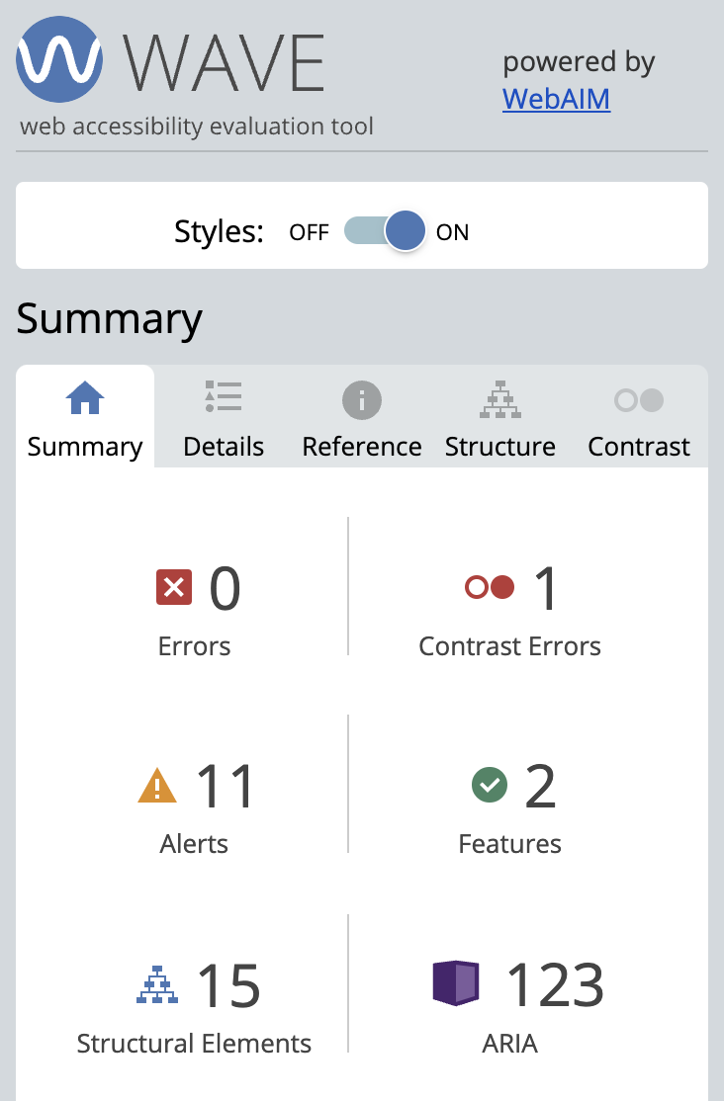
The QASP: accessible user interface
How to assess it day-to-day
Automated accessibility tools can test about 40% of potential accessibility concerns
Manual accessibility testing is necessary to check the rest
Notes:
Accessibility cannot be completely tested with automated tools. You can test about 40% of WCAG’s requirements with automated tools, but the rest have to be tested manually. There’s no way around it. For example, blind users may rely on a screen reader to describe the screen to them as they navigate around. Automated tools can’t “listen” to that and know whether or not the right things are being announced. A human has to do that navigation and listen. So if the state doesn’t have staff trained to do that kind of testing, you’ll either need to get training or contract that out separately from the product RFP to avoid a conflict of interest. There are free training programs out there that are really excellent, such as the Trusted Tester program from the Department of Homeland Security.

Slide 43
The QASP: accessible user interface
DISCUSSION:
Who will do the assessment?

Slide 44
The QASP: deployed code
Standard: Code must successfully build and deploy into [define which environments exist] environments.
Acceptable level: Deployment from version control of a successful build should be automated using industry standard tooling.
Method of assessment: Combination of manual review and automated testing.
Notes:
For deployed code, here we’re talking about the product being deployed into the appropriate environment, automatically. So if you have, for example, a production environment and a staging environment, then maybe every change gets deployed straight to the test environment, but changes only get deployed to production when a product owner clicks a certain button. The acceptable level talks about industry-standard tooling, and that’s just to make it easier to swap in team members or vendors, so your product is more adaptable to change.

Slide 45
The QASP: deployed code
A product that serves users’ needs…
…requires conducting research with users to understand their needs…
…requires rapid feedback on ideas to see how the product is meeting or missing their needs…
…requires rapid iteration on the product design and implementation
Notes:
Code that isn’t deployed isn’t helping anyone do anything. Code that deploys automatically and frequently, though, is a boon for rapid iteration. It’s not uncommon to deploy a dozen times a day or more, which is part of the reason you have multiple environments, honestly. It could be a rotten user experience to have something change right in the middle of you doing it. But being able to quickly make changes and then have the whole team see it and talk about it is valuable, and that indirectly helps you serve users’ needs.

Slide 46
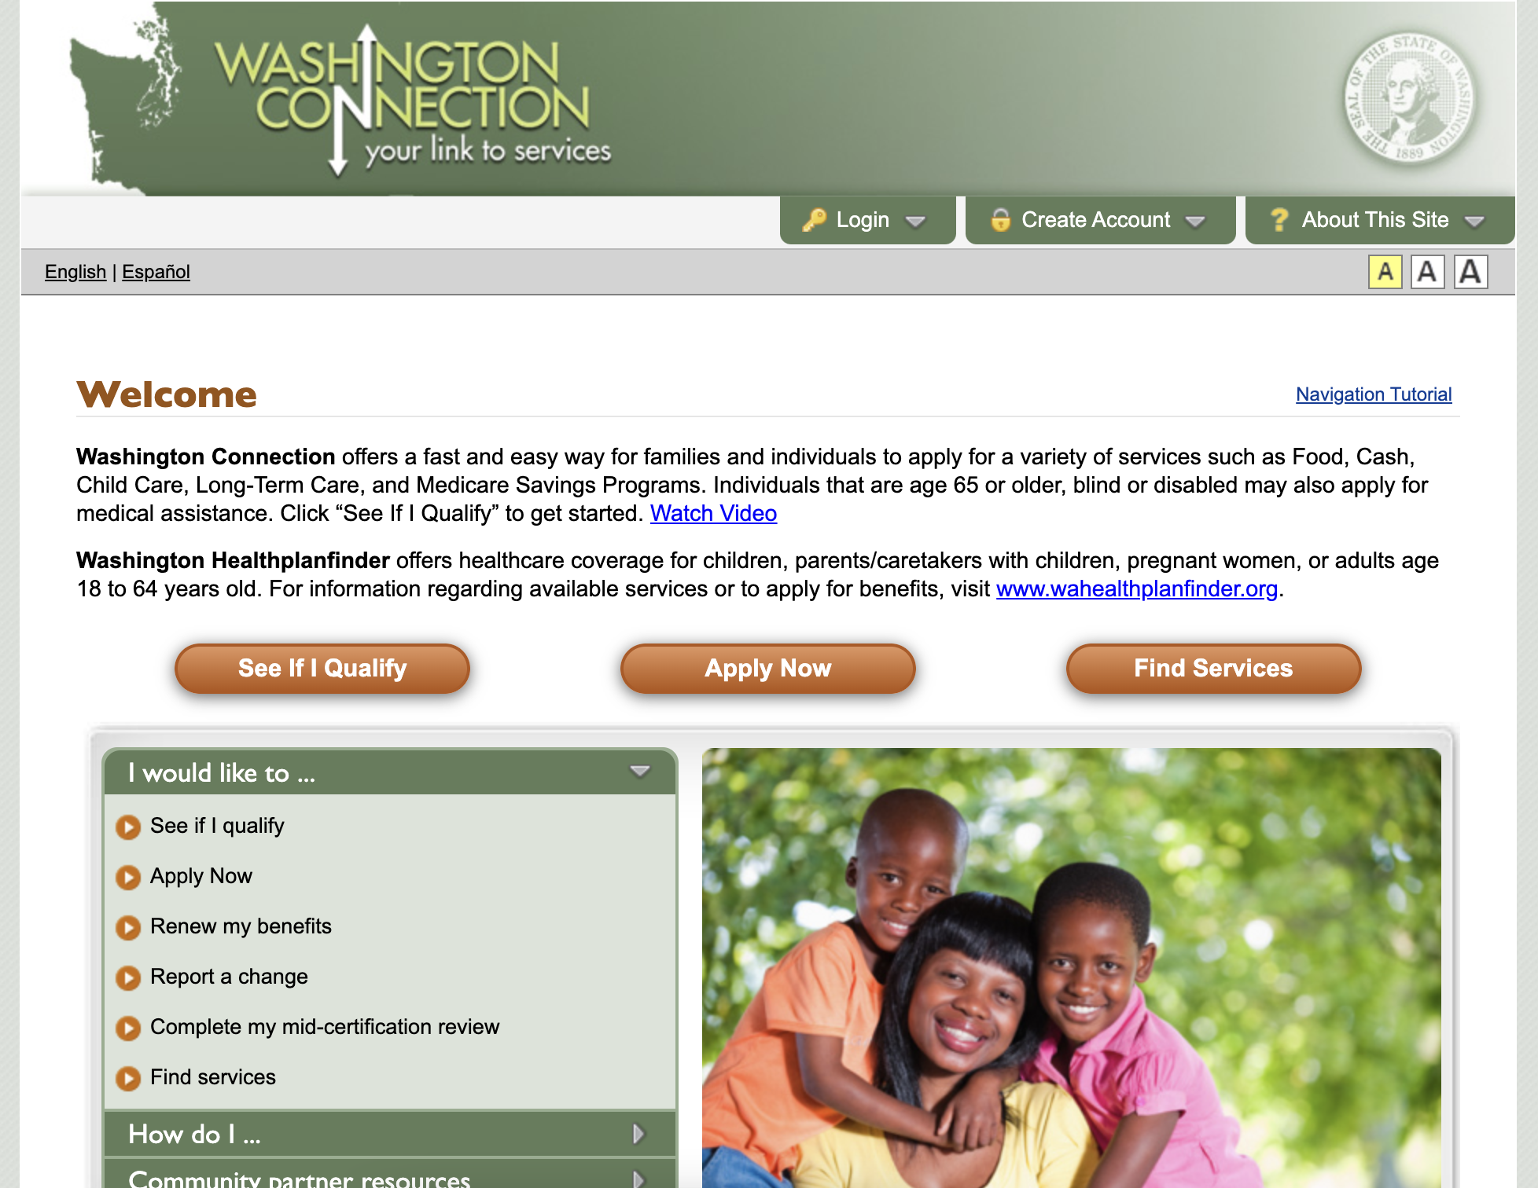
The QASP: deployed code
How to assess it day-to-day
Automated deployments will report if they fail
Manual testing will verify that the latest version deployed and new features are working as expected
Notes:
Your automated deployments should report if they fail. It could be that they send you an email or maybe you have to actually go look at the output, but they shouldn’t silently fail. So to some degree, there’s automated checking. You can also use the product yourself to verify that it’s the latest version and things work as expected.

Slide 47
The QASP: deployed code
DISCUSSION:
Who will do the assessment?

Slide 48
The QASP: documented decisions
Standard: Summary of stories is maintained, dependencies are listed, major functionality is documented, security and compliance controls are documented and maintained.
Acceptable level: All required documentation exists and is maintained.
Method of assessment: Manual review.
Notes:
Last week Austin talked about the value of documentation, even in agile projects. It’s so important that we actually require it. But like they said last week, we change our documentation focus to be on the things that will help us in the future, not reporting on the present. So we’d want things like how the product works, why it works that way, what security controls we have, if our security tests are returning any false positives, what are they and why? The goal is to make sure the team in 6 months isn’t doing the same work again.

Slide 49
The QASP: documented decisions
A product that serves users’ needs…
…requires conducting research with users to understand their needs…
…requires rapid feedback on ideas to see how the product is meeting or missing their needs…
…requires rapid iteration on the product design and implementation
Notes:
Having good, meaningful documentation helps enable rapid iteration by making it unnecessary to spend time solving the same problems again. Once you’ve figured out a good solution and it’s documented, you can just refer back to your notes. Or if you’re planning a big change, you can look at your documentation to see why it is the way it is which can give you really valuable context to prevent you from accidentally removing a user need.

Slide 50
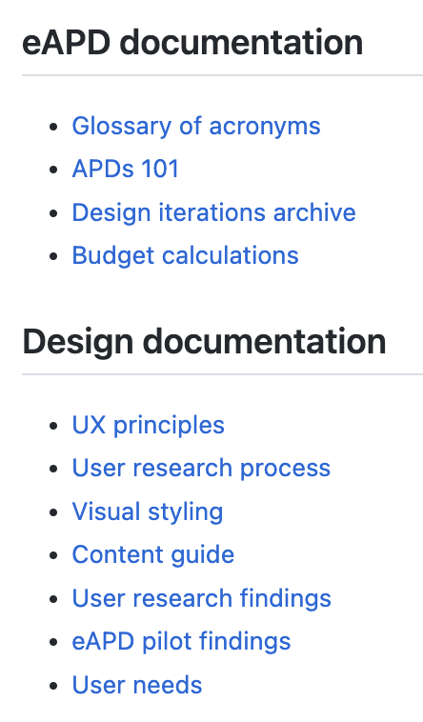
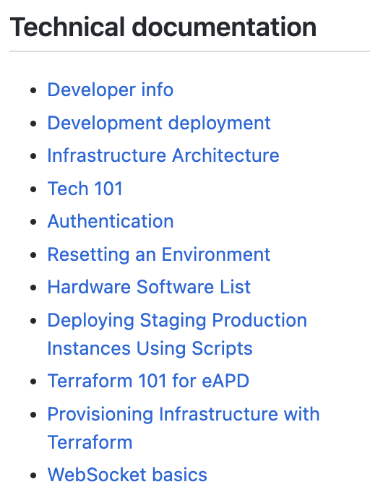
The QASP: documented decisions
How to assess it day-to-day
Manual review will ensure that changes are documented appropriately to prevent duplicative work in the future
Notes:
There’s really no way to assess documentation other than manual review. And because of the wide variety of documents that need to be reviewed, you might actually have several people with responsibility for it, depending on which documents are being updated.

Slide 51
The QASP: documented decisions
DISCUSSION:
Who will do the assessment?

Slide 52
The QASP: secure code
Standard: Code is free of known static and runtime vulnerabilities.
Acceptable level: Code submitted must be free of medium- and high-level static and dynamic security vulnerabilities. False positives are documented.
Method of assessment: Automated testing using a static testing tool (e.g., Snyk, npm audit, etc.), dynamic testing tool (e.g., OWASP ZAP), and manual code review informed by security standards and testing results.
Notes:
We all know the emphasis around security these days, and that’s for good reason. You don’t want to put Washingtonians’ data at risk where it could be exploited for identity theft, and you don’t want your services knocked offline so that they can get the things they need. So we have an element here about making sure the code is secure, as best we can tell.

Slide 53
The QASP: secure code
A product that serves users’ needs…
…requires conducting research with users to understand their needs…
…requires rapid feedback on ideas to see how the product is meeting or missing their needs…
…requires rapid iteration on the product design and implementation
Notes:
Making sure the product is secure just serves the users’ needs. It doesn’t help with any of the other stuff, but as I mentioned on the last slide, securing the product helps protect them from identity theft and it helps make sure they can get the services they need. Often we think of security as this big scary thing we’re going to get in trouble for if anything goes wrong, but I prefer to think of it in terms of the value it provides to users. I could talk for a long time about security – I studied information assurance in college, a long, long time ago – but the point is, it serves a legitimate user need.

Slide 54
The QASP: secure code
How to assess it day-to-day
Automated tests will identify a wide range of typical security issues and vulnerabilities
Manual review will ensure that any false positives identified by the automated tests are appropriately documented
Notes:
Thankfully, a lot of security analysis can be automated. There are a variety of tools that can poke and prod at your product to test it for a whole slew of common vulnerabilities. Because it turns out the 10 most common vulnerabilities have been mostly the same for the past 10 years or so. So we’ve gotten good at detecting those with automated tools like OWASP ZAP, a free, open source tool that you can setup in your continuous integration processes. There are also tools that will let you know about any known security vulnerabilities in the 3rd-party dependencies that your product has. Tools like Snyk, shown as the last entry on this screenshot, will look at the National Vulnerability Database maintained by the National Institute of Standards and Technology to see if any of your dependencies are listed and will warn you about it. So automated scanning can do a lot of heavy lifting for us.
However, there’s still some manual review involved, really for two things. One is that sometimes the automated tests will give you a warning about something that’s not really an issue. You’ll need to manually review those cases to ensure that they are false positives and that they’re properly documented. The other thing you’ll need to manually review for is basically the same as code style, but especially looking for bad security practices that automated tools can’t catch. Like, for example, if the vendor tries to write their own cryptography code. That’s a big, big no-no. You always use well-established algorithms and libraries for that. Never write your own. But the tools can’t tell that’s what’s happening, so you have to put human eyes on it.

Slide 55
The QASP: secure code
DISCUSSION:
Who will do the assessment?

Slide 56
The QASP: researched needs
Standard: Usability testing and other methods are conducted at regular intervals throughout the product development process.
Acceptable level: Research plans and artifacts from testing/other methods are available at the end of relevant sprints, in accordance with the vendor’s research plan.
Method of assessment: Manual review.
Notes:
User research is essential in building a product that meets users’ needs. How else will you know what their needs are? This QASP element goes hand-in-hand with the documentation element earlier: we want to make sure the knowledge gained from user research is captured for future reference, so there’s less re-work. You don’t necessarily need to permanently capture things like raw interview notes, but a synthesized version of the notes with key takeaways is like gold.

Slide 57
The QASP: researched needs
A product that serves users’ needs…
…requires conducting research with users to understand their needs…
…requires rapid feedback on ideas to see how the product is meeting or missing their needs…
…requires rapid iteration on the product design and implementation
Notes:
Those design artifacts are important for addressing user needs, but they also enable all of the things that help us get to user needs. If you have user research notes from a couple weeks ago, that can help you decide how to direct the next round of research this week, like whether you need to focus in on one specific problem users were having or if you maybe want to try out a new solution to that problem. These design artifacts also help with rapid iteration by giving the designers and engineers a grounding in what they’re solving for, which helps avoid the bikeshedding problem, where you spend so much time debating the color of the bike racks that you forget to build the theater.

Slide 58
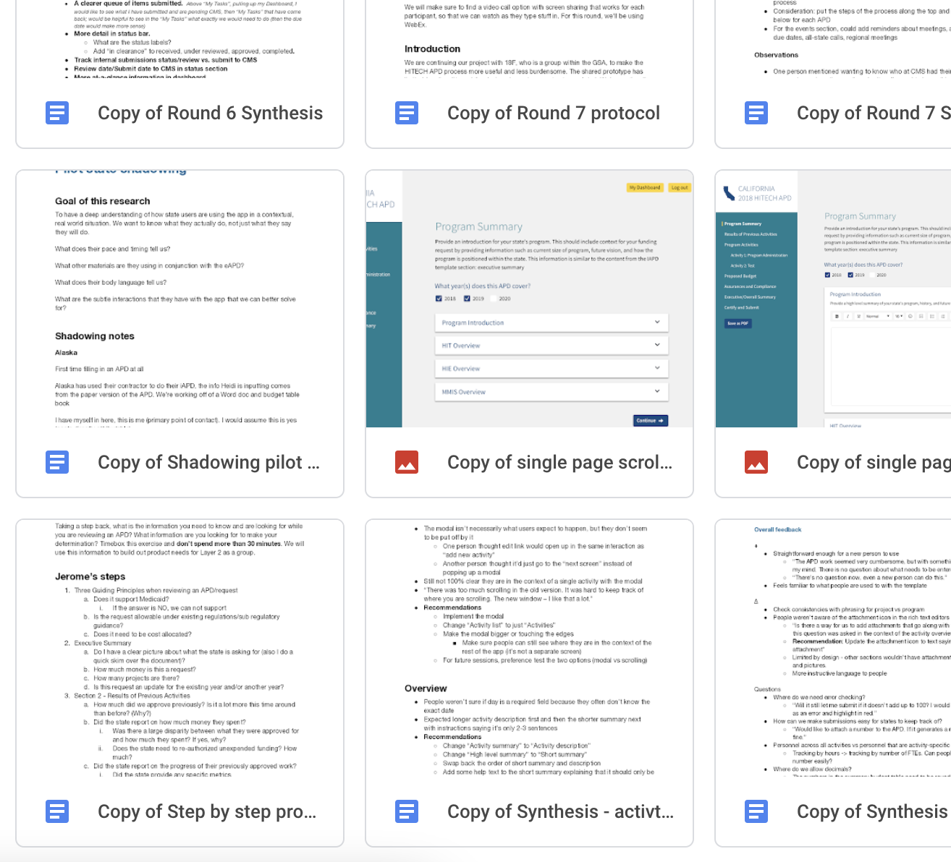
The QASP: researched needs
How to assess it day-to-day
Manual review will ensure that research artifacts have been generated and captured
Notes:
This is also a manual review process. Ideally the product owners are involved in the day-to-day user research to help them make the best decisions about where the product needs to go, which makes it easier to determine if the right documentation has been captured. In any case, seeing that the documentation is present and contains useful information is a manual process.

Slide 59
The QASP: researched needs
DISCUSSION:
Who will do the assessment?
Notes:
Austin: This is largely dependent on how much the POs want to be involved in user research. In my opinion, the more active you are in usability testing and research, the easier it will be to make product decisions. There’s the part about just making sure research is being done vs. how much of that research is being centered in the decision making.
Also, design research introduces bias and different people pick up on different perspectives. The more people involved in synthesizing research, the better.

Slide 60
The QASP: accepted features
Standard: At the beginning of each sprint, the product team will collaborate to define a set of user stories grounded in user research to be completed. The development team will deliver functionality to satisfy these user stories. Code is continuously available in a version-controlled source code repository owned by the State.
Acceptable level: Delivered code meets the acceptance criteria of each user story. Incomplete stories will be considered for the next sprint.
Method of assessment: Manual review.
Notes:
Accepted features means that the product owners have determined the vendor’s work on a particular feature is good enough. Simple as that! This requirement also means that the state will own the code repository, which is partly about also making sure the state owns the code but also that you have access to it at all times.

Slide 61
The QASP: accepted features
A product that serves users’ needs…
…requires conducting research with users to understand their needs…
…requires rapid feedback on ideas to see how the product is meeting or missing their needs…
…requires rapid iteration on the product design and implementation
Notes:
Features should only be accepted if they serve user needs. Accepting a feature is the culmination of all the other stuff on this slide. While you will likely revisit this feature in the future, it is basically “done” for now. Having product owners determine when that happens is how we ensure that the feature is actually delivering value to our users.

Slide 62
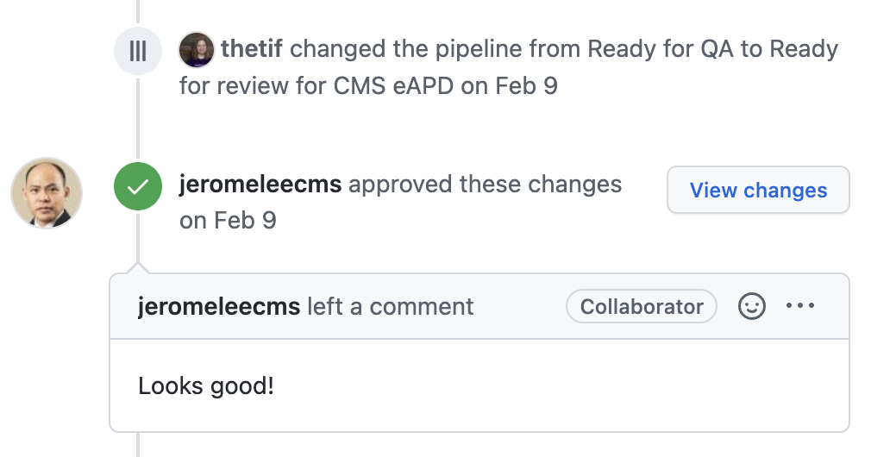
The QASP: accepted features
How to assess it day-to-day
Automated tests will identify a wide range of typical security issues and vulnerabilities
Manual review will ensure that any false positives identified by the automated tests are appropriately documented
Notes:
For all of the parts of the QASP with automated checks, those should roll up into a view where the product owners can see that a feature is passing everything it’s supposed to. If anything is failing, the product owners can decide what to do about that: is it a risk worth accepting right now, or should the feature be held up? For the manual parts, the product owners can ensure those have been done too. And remember that the product owner doesn’t actually have to do any of these checks. They absolutely can get other members of their team to do it and return with feedback and advice.
At the end, the product owner will approve or deny the feature. Here, you can see Jerome Lee, a state officer at CMS, approving a new feature for eAPD.

Slide 63
The QASP: accepted features
DISCUSSION:
Who will do the assessment?
Notes:
This one… pretty much better be the product owners.

Slide 64
The QASP is a framework you can use to roughly measure the quality, health, and sustainability of your product, team, and processes.
Notes:
So to wrap up, the QASP doesn’t give you a quality product. It doesn’t guarantee that you meet user needs. But what it can do is give you insight into how well the product is meeting user needs, in a way that paper deliverables cannot. It can tell you about the sustainability of your work, and it can tell you about not just the product, but the team and your processes as well. The QASP isn’t meant to be the end-all, be-all of getting your desired outcomes, because that’s really what you have to do, but it can give you the metrics you need in order to know how you’re doing.

Slide 65
Agile contract format

Slide 66
Agile Contract Format
descriptive instead of prescriptive
STATEMENT OF OBJECTIVES (SOO)
Background & purpose
Scope & objectives
Contract period of performance (PoP), place of performance, and contract type
Operating constraints
Instruction & evaluation
‹#›
Notes:
Why did we create this? We needed a crosswalk between the contracting world and the development world.

Slide 67
Agile Contract Format
STATEMENT OF OBJECTIVES (SOO)
Background & purpose
self-explanatory
Scope & objectives
Contract period of performance (PoP), place of performance, and contract type
Operating constraints
Instruction & evaluation
‹#›

Slide 68
Agile Contract Format
STATEMENT OF OBJECTIVES (SOO)
Background & purpose
Scope & objectives
product vision, draft user stories (if available), quality assurance and surveillance plan (QASP)
Contract period of performance (PoP), place of performance, and contract type
Operating constraints
(We did this part on Monday)
Instruction & evaluation
‹#›

Slide 69
Agile Contract Format
STATEMENT OF OBJECTIVES (SOO)
Background & purpose
Scope & objectives
Contract period of performance (PoP), place of performance, and contract type
Under 3 years duration, distributed place of performance where possible, time & material with a not-to-exceed ceiling mechanism
Operating constraints
Instruction & evaluation
‹#›

Slide 70
Agile Contract Format
STATEMENT OF OBJECTIVES (SOO)
Background & purpose
Scope & objectives
Contract period of performance (PoP), place of performance, and contract type
Operating constraints
infrastructure, security parameters, data clauses, etc
Instruction & evaluation
‹#›

Slide 71
Agile Contract Format
STATEMENT OF OBJECTIVES (SOO)
Background & purpose
Scope & objectives
Contract period of performance (PoP), place of performance, and contract type
Operating constraints
Instruction & evaluation
(1) technical approach, (2) staffing approach, (3) similar experience, and (4) price
‹#›

Slide 72
Questions & discussion

